Slide 1
An Evolution of a Mindset: A Historical Perspective on Sandia National Laboratories Fire Science Philosophy
Stanford ICME Seminar Series
January 30th, 2020 Stanford University
Stefan Domino, Ph.D.
Computational Thermal & Fluid Mechanics
Sandia National Laboratories SAND2019-15457 PE

Slide 2
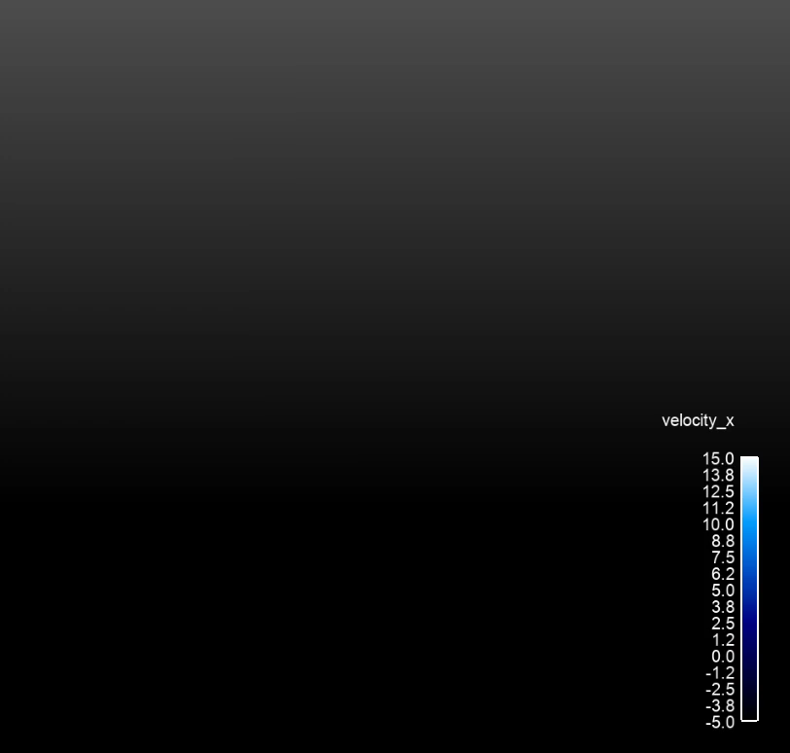
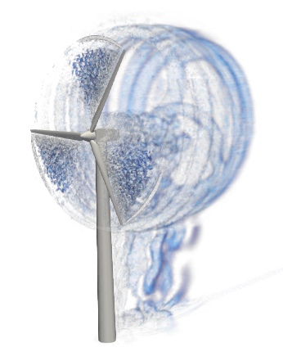
Complex Non-Conformal and Meshing Drivers
Wind energy applications drive overset and sliding mesh
(Vestas V27 225 kW wind turbine simulation), see https://ExaWind.org

Slide 3
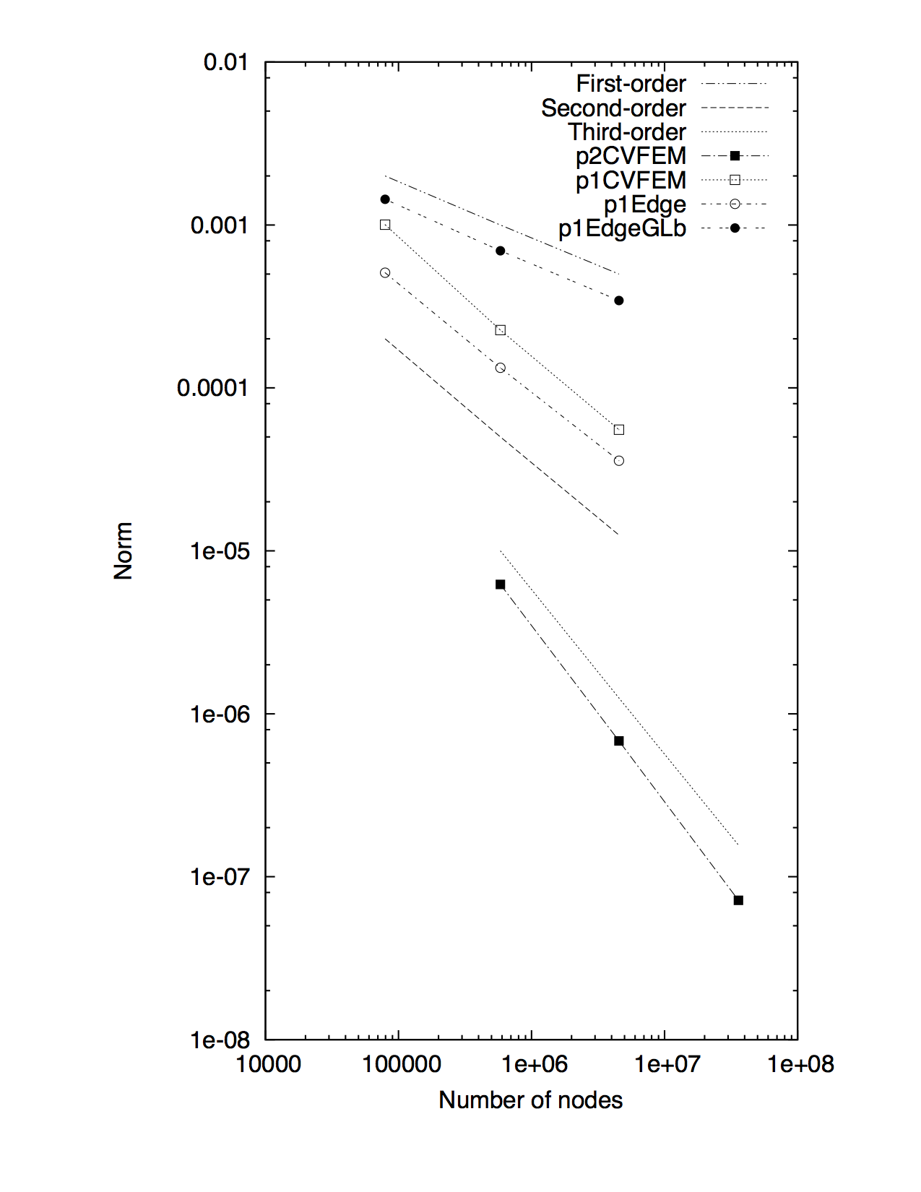
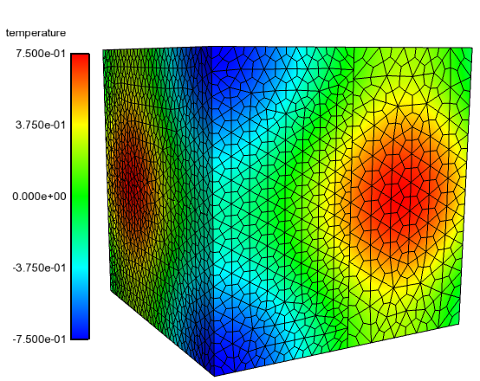
Design-order Mesh Constructs for Non-Conformal Interfaces
Non-conformal and overset methods provides ease of meshing and, when required, mesh motion
Design-order hybrid DG/CVFEM established, see: Domino, JCP, 2018
Research Thrust: Combine with overset….
Non-conformal MMS

Slide 4
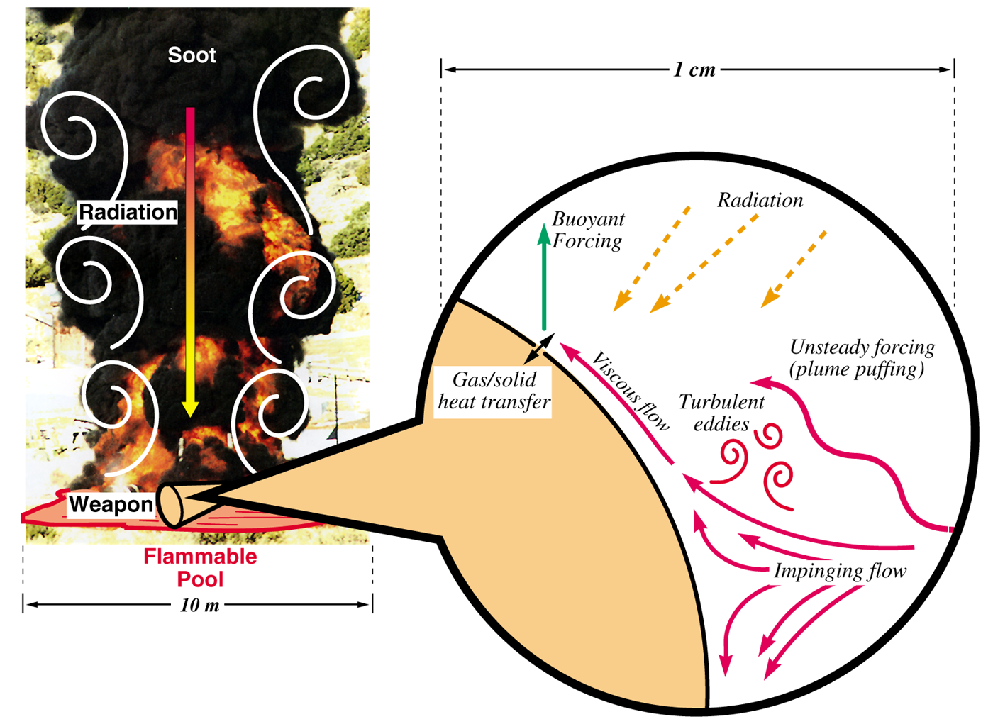
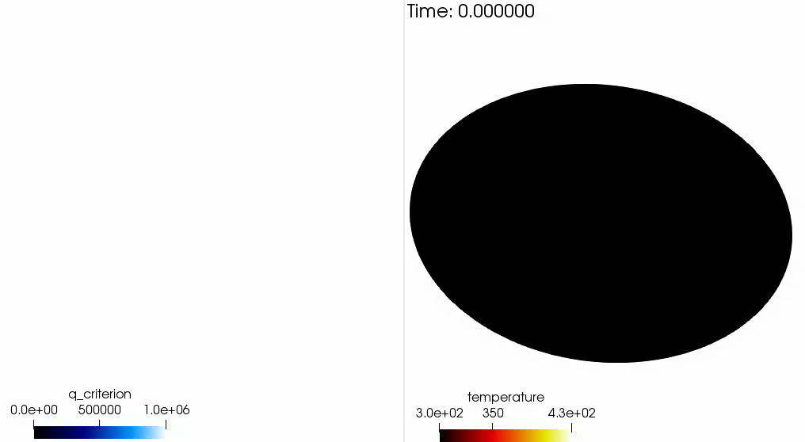
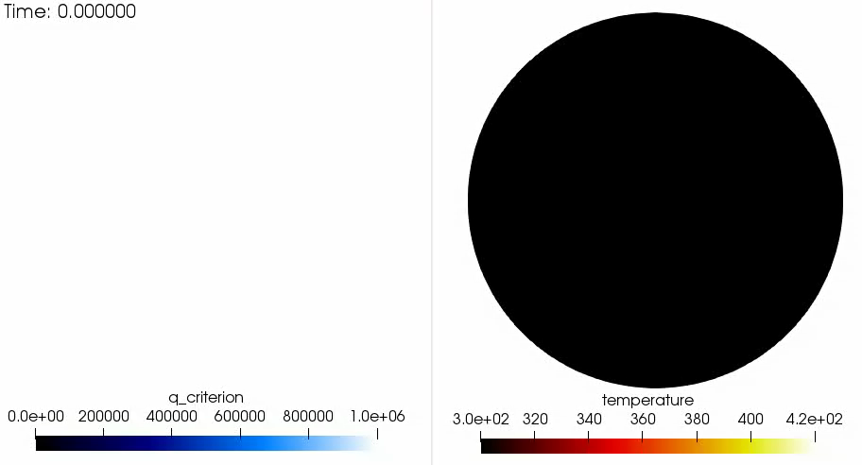
Research Thrust: Foundational advances for Non-isothermal Impinging Jets
Systems within the Abnormal Thermal Environment experience pressurization due to internal thermal decomposition of common materials
At critical component pressures, venting of hot combustible gas occurs either by system design or structural failure
Venting events are characterized by an impinging turbulent non-isothermal jet blowdown
Direct Numerical Simulation (DNS) effort is being used to understand low-Mach non-isothermal jet impingement (hot jet, cool surface) heat transfer
Simulations are being run up to 15 billion mesh nodes on up to 384,000 processors (6000 KNL nodes at 64 MPI-rand/node)
This DNS is also supporting Machine-learning objectives for, e.g., ML-based wall-modeled LES, and deep neural network authentication methods development
object
Un-confined impinging jet
Confined impinging jet

Slide 5
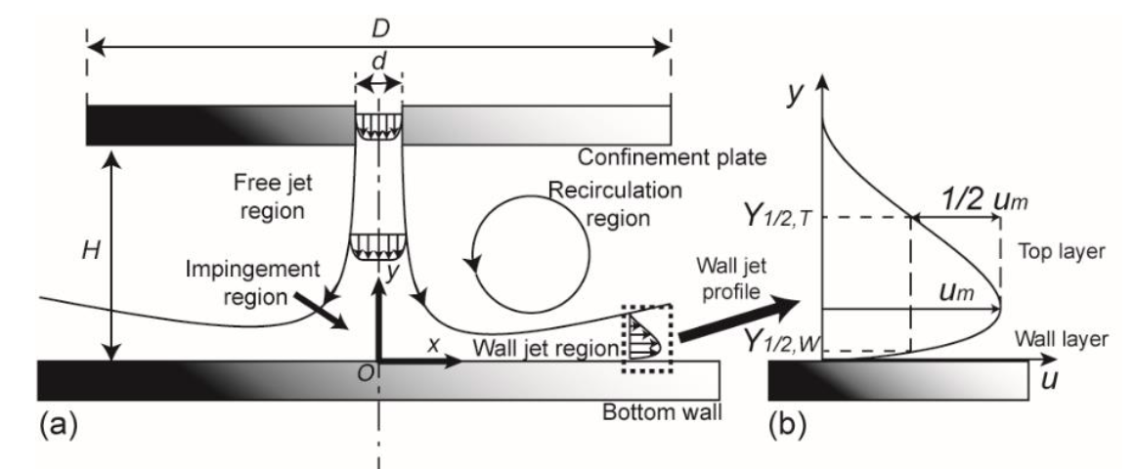
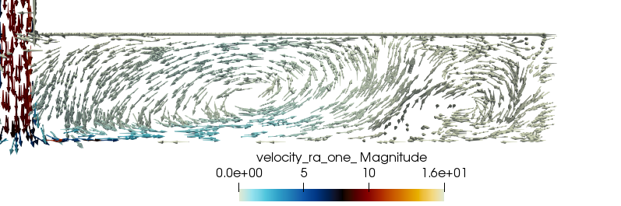
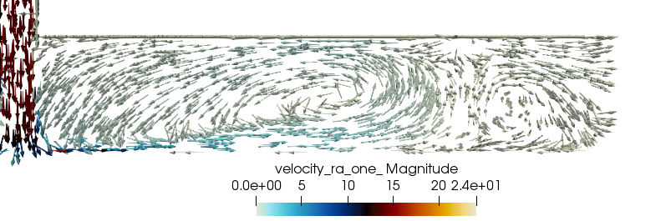
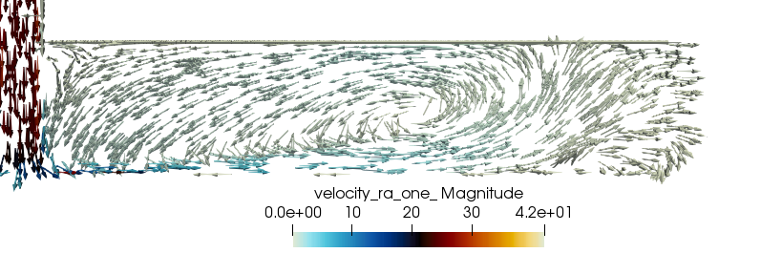
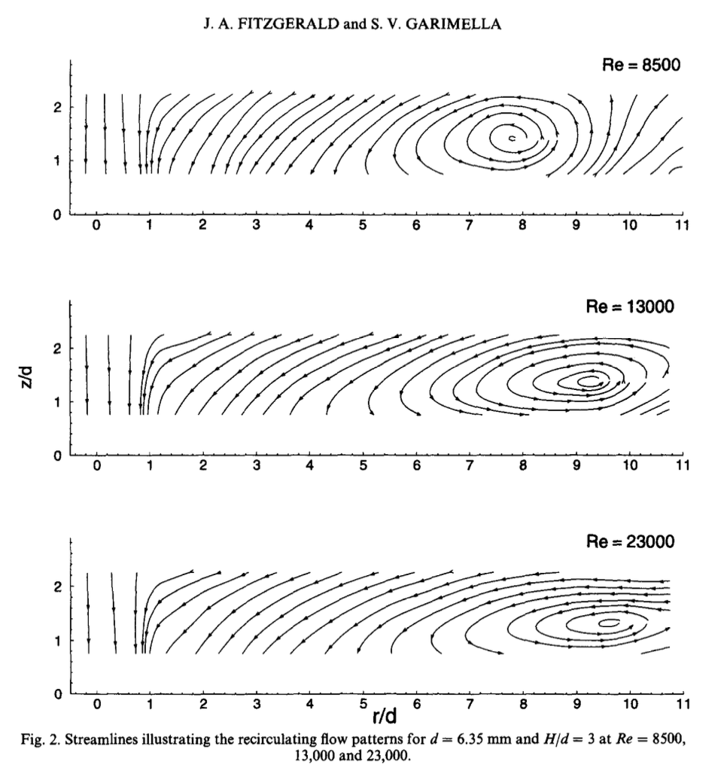
Confined Impinging Jet Challenges
Triple-layer structure comprised of:
Free-jet region
Impinging/stagnation region
Wall jet with boundary layer transition and large scale recirculation
Recirculation region can drastically affect the heat-flux radial profile at the impingement plate
Flow includes localized high-strain, high-curvature regions, with near-stagnation point negative turbulent production of kinetic energy breaks RANS and LES
Guo, Ph.D. Dissertation, 2013
Re 8,500
Re 13,000
Re 23,000
(top) current WALE-WMLES study (Domino, 2020)
(bottom) Fitzgerald and Garimella, Int. J. Heat Mass Transfer, 1998
Notes:
Triple-layer structure comprised of:
Free-jet region
Impinging/stagnation region
Wall jet with boundary layer transition and large scale recirculation
Recirculation region can drastically affect the heat-flux radial profile at the impingement plate
Flow includes localized high-strain, high-curvature regions, with near-stagnation point negative turbulent production of kinetic energy
Flow complexity limits usage of low-fidelity approaches, i.e., RANS, and challenges higher-fidelity approaches, i.e., LES
Due to the triple-layer structure, DNS has been limited to lower Reynolds number jets, i.e., in the 1K-5K range, and generally focus on either isothermal jets or cold jets that cool a hot surface

Slide 6
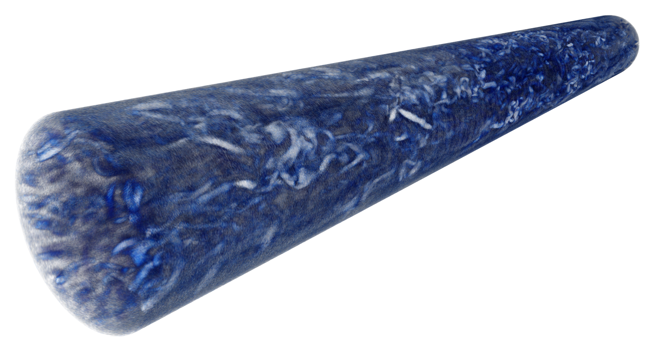
Re ~10,000 DNS Impinging Jet Simulation Study
Four inlet jet temperatures (25C, 100C, 300C, and 600C)
Gap height / jet dimeter; H/D = 3
Jet radius / domain diameter; R/D = 15
Near-wall pipe and impingement plate resolution, 10⁻⁵ m
Bulk region near Kolmogorov length scale ~0.01 mm
Base mesh ~1.8 billion Hex8 elements (pipe, O(100) million)
Refined mesh in P ~ 15 billion nodes, Hex27 mesh; ~800 gig
DNS pipe flow precursor (Re^{τ} = 505) provides extremely well characterized inflow condition
See: Wu et al., PNAS, 2015 for pipe complexities (transition UQ related)
Volume-rendered Q-criterion
and barycentric map (100C)

Slide 7
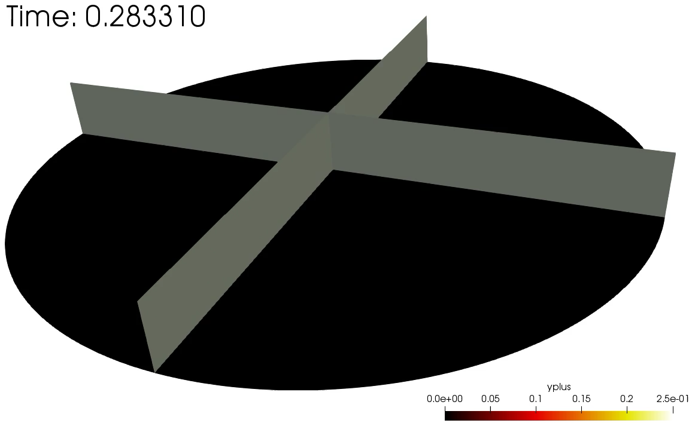
Re ~10,000 DNS Impinging Jet Simulation Study (preliminary)
25C and 100C nearly complete (statistics)
Variable T^{jet} core collapse behavior is consistent with axisymmetric round jet experiment of Russ and Strykowski, Phys. Fluids, 1993
100C
100C

Slide 8
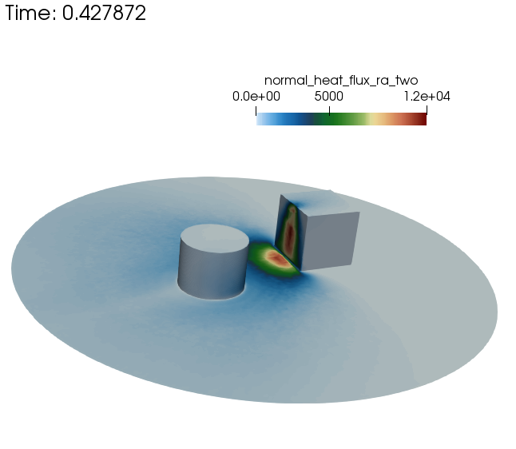
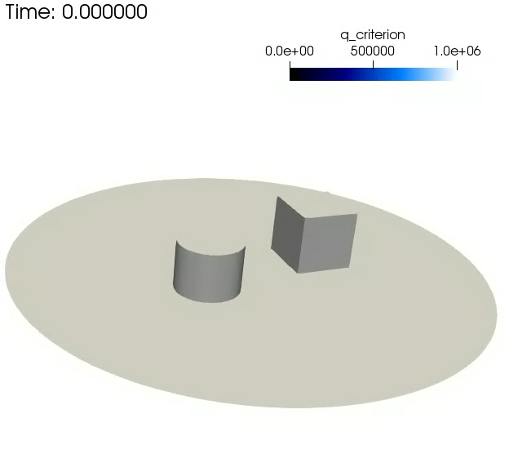
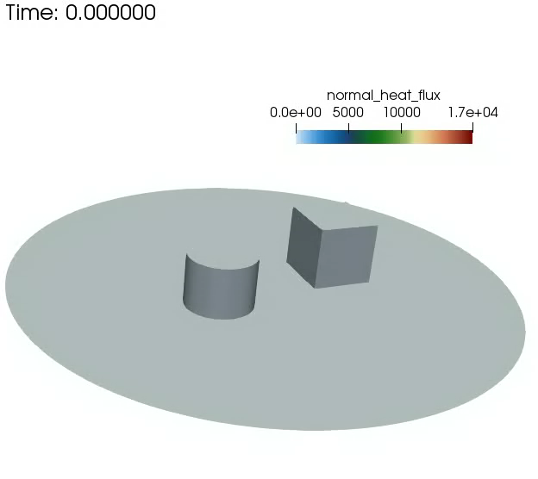
Research Thrust: Impinging Jet Fluid Mechanics in the Presence of Clutter
Real systems include clutter and jet impingement obstructions that can drastically affect the flow pattern
Complex geometries require generalized unstructured or high-order tetrahedral capability
Tet-based WMLES approach shown below with entrance pipe region
Expected proposal for joint experimental and numerical design project

Slide 9
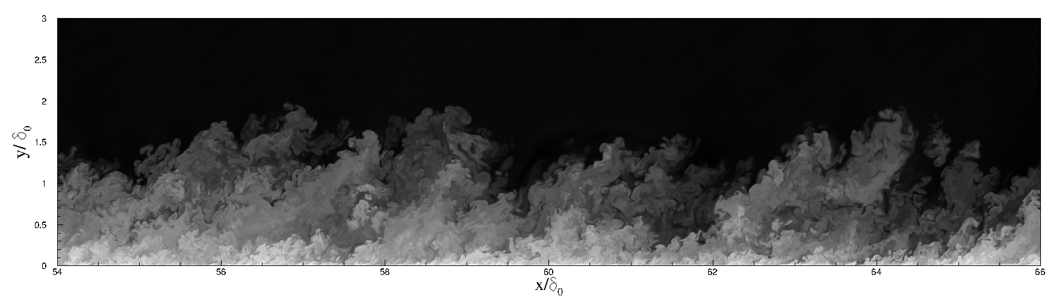
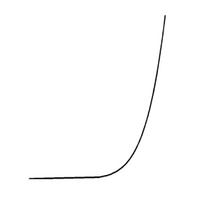
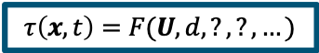
Research Thrust: Partnership with Dr. Matthew Barone, 1515 Near-wall Turbulence Modeling in Large Eddy Simulation
Mean Velocity
Turbulence
Solid Surface
Notional Direct Numerical Simulation (DNS) mesh
Notional LES mesh
Resolved Eddies
Decreasing eddy size
Modeled Eddies
Wall Shear Stress
$$τ\left(x,t\right)=F(U, d, ?, ?, …)$$
Wall-modeled LES offers computational savings decrease of at least several orders of magnitude over DNS for engineering systems of interest.
DNS ~ Re³
LES^{outer} ~ Re^{0.4}
WRLES~Re^{1.8}
Chapman, AIAA J., 1979
Notes:
This slide shows what is happening in a near-wall turbulence model. The smallest eddies close to the wall can only be resolved using a very fine mesh (DNS), which is unaffordable at production Reynolds numbers. We resort to applying a model for the action of these eddies, leading to “Wall-modeled LES”.

Slide 10
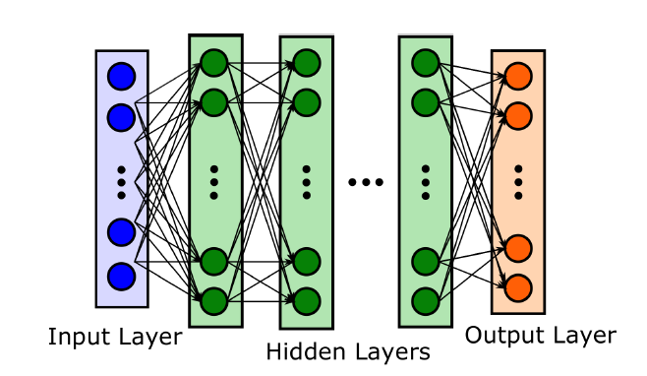
The Research Question
Key Premise:
New near-wall turbulence models based on traditional approaches - theory, phenomenology, and limited calibration to data - will not result in significant improvements in predictive accuracy for surface loading simulations.
Research Question:
Can data-driven models, constructed using machine learning techniques, provide a novel path forward for near-wall turbulence models with improved accuracy for surface loading predictions?
Decision Tree/Random Forest
Neural Network, or Multi-Layer Perceptron (MLP)
X⁽²⁾ < 0.4
X⁽²⁾< 0.2
X⁽¹⁾< 0.2
Y = 0.5
X⁽¹⁾< 0.5
Y = 2.1
Y =0 .3
Y = 1.2
Y = -0.2
(hard to constrain)
(possibility to constrain)
Notes:
The premise leading to our research question, followed by the research question itself. The images depict the two machine learning algorithms employed in the present work. Both of these algorithms can describe a general function mapping multiple features, or inputs, to multiple outputs, or labels. The Random Forest is an ensemble of decision trees, which are comprised of a number of splits on the input features which create branches of the tree. The neural network is comprised of an input layer of features, a number of hidden layers, and an output layer. The nodes in each layer are densely connected to the nodes of adjacent layers. The process of training the neural network involves optimization of the weights of each node to provide an optimal prediction of the outputs.

Slide 11
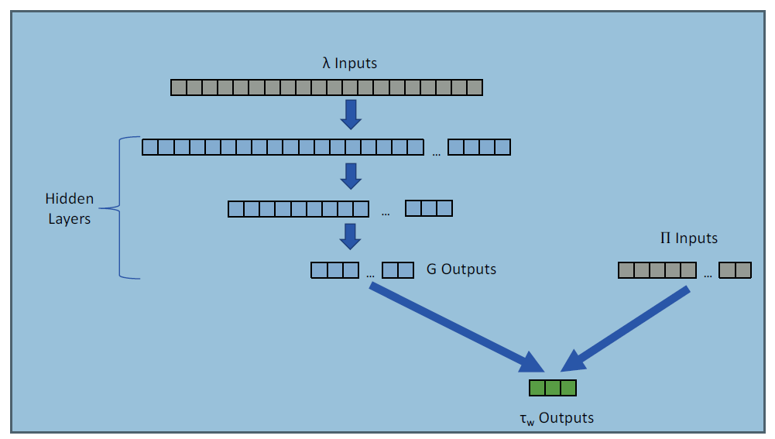
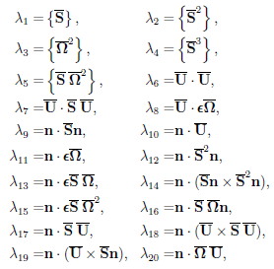
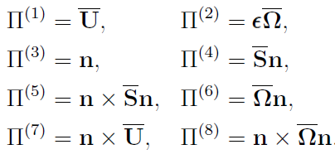
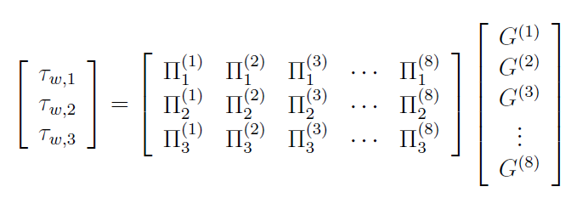
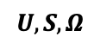
Constructing a Coordinate-Frame Invariant Near-Wall Turbulence Model [1]
n
The wall shear stress model must be applicable for:
Arbitrary Cartesian coordinate system
Arbitrary orientation of the wall
This fundamental property is ensured by using tensor invariant theory to identify:
The appropriate invariant features (inputs) to the model
A representation of the wall shear stress vector invariant to rotations about the wall-normal vector
x
$$U, S, Ω$$
Scalar invariant inputs
Form invariant inputs (vectors)
[1] Inspired by Ling, Kurzawski, and Templeton, “Reynolds averaged turbulence modelling using deep neural networks with embedded invariance.” J. Fluid Mech. 807:155-166, 2016.

Slide 12
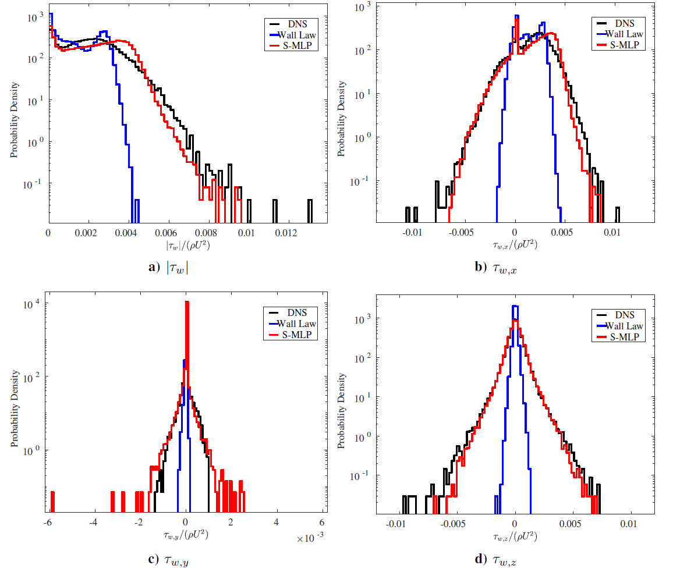
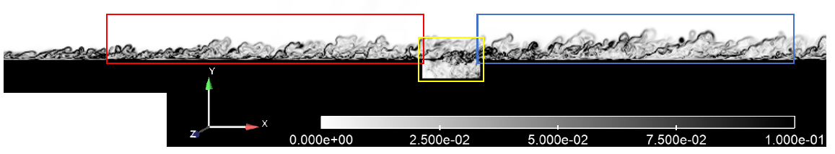
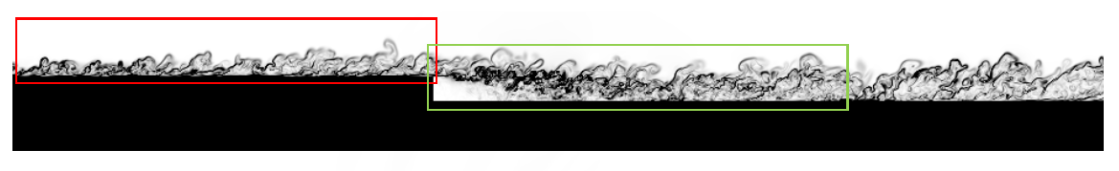
A Priori Tests of the ML Wall Shear Stress Model
Training Data
Test Case
In this application space, mean quantities are not enough!
The PDF for wall shear is desired to be modeled accurately

Slide 13
Conclusions
The dynamics of fire is a multi-physics and highly non-linear
As crossflow increases, the likelihood of whirling fire events increases
Damaged bodies/clutter (not discussed) also increases mixing and, hence,
Coupling low-Mach reacting flow with PMR and CHT requires stable and accurate operator split approaches
Active Research Thrusts:
Quality numerical methods deployment is required to ensure stable, accurate, and convergent analysis especially when applied to complex geometries
A quality VVUQ effort includes assessment of numerical accuracy, model-form uncertainties, and evaluation of the assumed physics
Automatic uncertainty approaches for LES are developing
DNS can provide valuable insight to complex physics, especially, when capability computing is deployed
Machine learning approaches are being evaluated and developed for wall-modeled LES (CTRSP)

Slide 14
Acknowledgements
Funding:
ASC Integrated Codes, Physics and Engineering Models, and Verification and Validation portfolios
Exascale Computing Project (17-SC-20-SC)
Sandia National Laboratories Staff:
Dr. Alex Brown (square quiescent fire simulation)
Dr. Sarah Scott (fire in crossflow partnership activities)
Dr. Matt Barone (machine-learning partnership research thrust)
Notes:
n/a

Slide 15
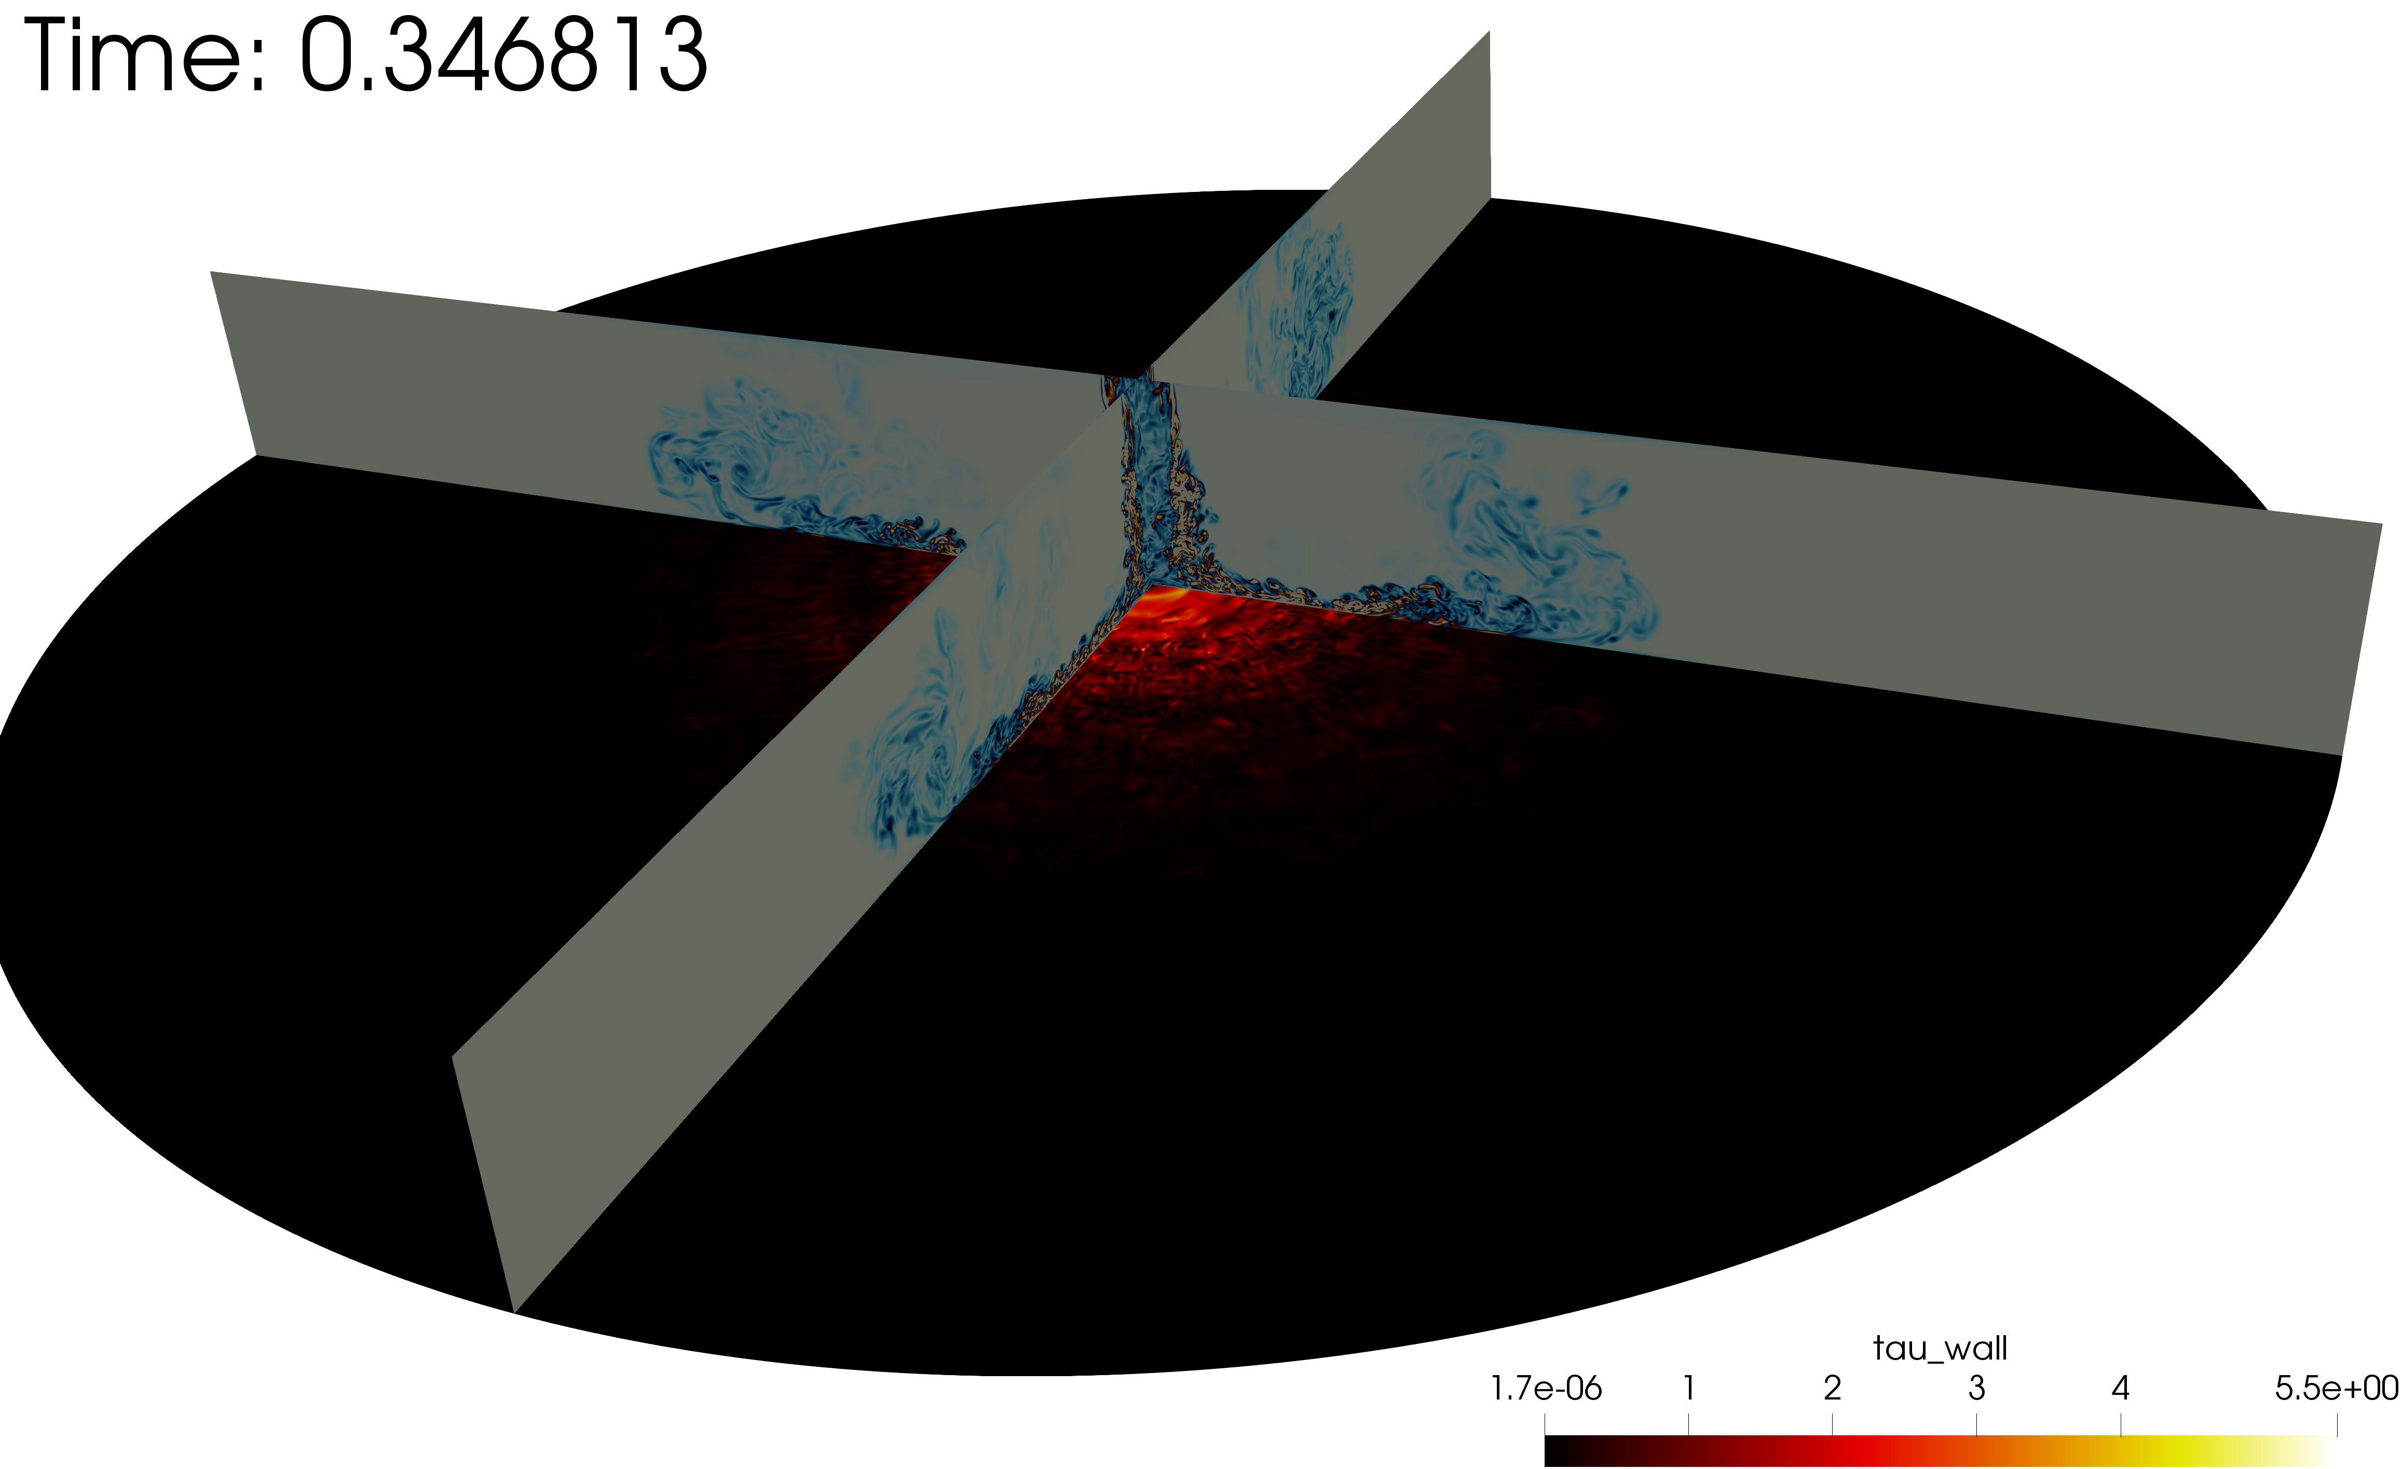
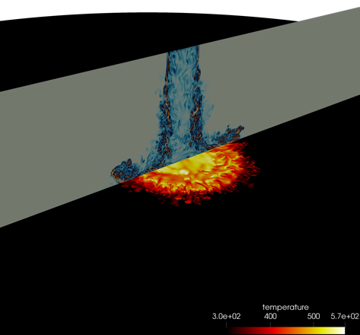
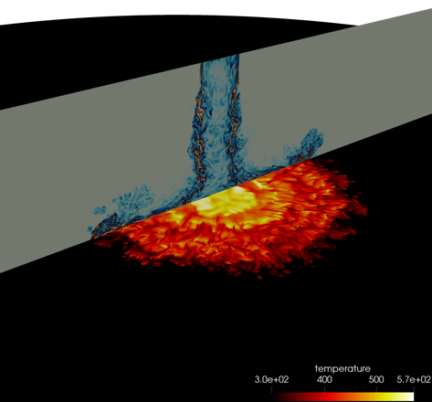
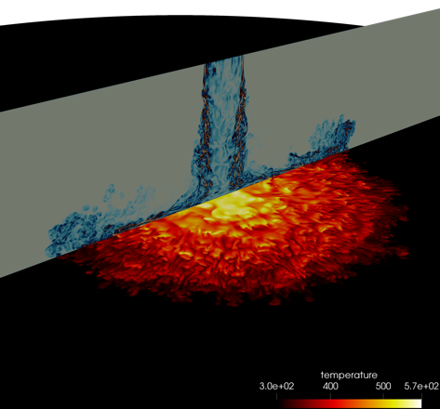
“Indeed, all I can say to you at the end of these lectures (for we must come to an end at one time or other) is to express a wish that you may, in your generation, be fit to compare to a candle; that your may like it, shine as lights to those about you; that, in all your actions, you may justify the beauty of the taper by making your deeds honorable and effectual in the discharge of your duty to your fellow-men.”
The Chemical History of a Candle, Michael Faraday (1791-1867)
Vertical plane of vorticity shadings with near-wall impingement plane of temperature shadings for the 300C inlet jet temperature. For this jet sequence, six restarts were required (each using the full 24-hour Trinity KNL run time limit).

Slide 16
Seminar Announcement
Title: An Evolution of a Mindset: A Historical Perspective on Sandia National Laboratories Fire Science Philosophy
Abstract:
Sandia National Laboratories continues to develop and deploy a comprehensive experimental, modeling, and simulation program whose goal is to drive foundational advancements in fire physics understanding. The abnormal thermal environment, which is classically characterized as a highly sooting hydrocarbon combustion event, arises during an accident scenario in which a breached liquid inventory reacts. Fully or partly engulfed objects subjected to an abnormal thermal environment are both radiatively and convectively heated. This multi-physics event can be defined as a low-Mach, turbulent reacting flow coupled to soot transport, thermal radiation, and thermal response. Accident use-cases that include propellants or carbon fiber-based materials add Eulerian/point-particle Lagrangian physics and/or heterogenous combustion coupling, respectively. In fact, over the past three decades, representative accident scenarios of interest have changed. For example, early use-cases focused on large-scale hydrocarbon outdoor pool fires (JP-8) in quiescent conditions. Recent experimental and theoretical research efforts have demonstrated that the inclusion of an environmental cross-flow dramatically augments heat loading to objects due to increased fuel/air mixing efficiency that counter-rotating vortex structures provide. In the most extreme case, fire whirls are present. Fire whirling phenomena are characterized by tornadic-like fluid pockets of reacting flow whose formation is dictated by the coupling of buoyant acceleration from the fire in the presence of environmental cross flow.
In this presentation, a history of fire physics understanding at Sandia National Laboratories Engineering Science Center will be provided. This journey will describe an evolution of mindset in fire mechanics understanding whose inception shares lineage with “The Chemical History of a Candle” [1] and extends to complex fire whirling behavior. The link between this evolution of a mindset/understanding and required experimental, modeling, and simulation pathways will be outlined. Fire experimental and simulation findings will be provided, in addition to an overview of fire physics fundamentals. The presentation will also include recent verification and validation research findings and numerical advances that map to a required fluid mechanics paradigm shift: blunt transition from Reynolds- Averaged Navier-Stokes (RANS) approaches to the incorporation of higher-fidelity turbulence simulation constructs such a large-eddy simulation (LES) and direct numerical simulation (DNS). Finally, future research paths will be outlined including accurate, low-dissipation low-Mach methods, VVUQ methods, and machine-learned wall-modeled LES appraoches.
[1] The Chemical History of a Candle, Michael Faraday, Royal Institution “Christmas lectures for young people”, 1825.

